Slide 2
Ephesians 5
7 Therefore do not be partners with them.
8 For you were once darkness, but now you are light in the Lord. Live as children of light 9 (for the fruit of the light consists in all goodness, righteousness and truth)

Slide 3
Ephesians 5
10 and find out what pleases the Lord.
11 Have nothing to do with the fruitless deeds of darkness, but rather expose them. 12 It is shameful even to mention what the disobedient do in secret.

Slide 4
Ephesians 5
13 But everything exposed by the light becomes visible—and everything that is illuminated becomes a light. 14 This is why it is said:
“Wake up, sleeper,
rise from the dead,
and Christ will shine on you.”

Slide 6
Ephesians 5:8
8 For you were once darkness, but now you are light in the Lord. Live as children of light
John 8:12 When Jesus spoke again to the people, he said, “I am the light of the world. Whoever follows me will never walk in darkness, but will have the light of life.”

Slide 7
Ephesians 5:8
So what does living as children of the light look like?
1 Peter 2:9 But you are a chosen people, a royal priesthood, a holy nation, God’s special possession, that you may declare the praises of him who called you out of darkness into his wonderful light.

Slide 8
Ephesians 5:9
(for the fruit of the light consists in all goodness, righteousness and truth)
1.GOOD
2. RIGHT
3. TRUE

Slide 9
Ephesians 5:10
and find out what pleases the Lord.
“Kids of the light are constantly trying to ascertain what the will of God is in every situation so that everything that they do will please HIM…”

Slide 10
Ephesians 5
11 Have nothing to do with the fruitless deeds of darkness, but rather expose them.
12 It is shameful even to mention what the disobedient do in secret.
13 But everything exposed by the light becomes visible—and everything that is illuminated becomes a light.

Slide 11
Ephesians 5
14 This is why it is said:
“Wake up, sleeper,
rise from the dead,
and Christ will shine on you.”

Slide 12
“It is a work of the Spirit. It’s what He does best! Christ shines His light into the darkness and it’s HIS LIGHT that illuminates or exposes people’s sin and His light that Wakes up the sleeper and they RISE from the dead and find SALVATION.”

Slide 13
Matthew 5
14 “You are the light of the world. A town built on a hill cannot be hidden. 15 Neither do people light a lamp and put it under a bowl. Instead they put it on its stand, and it gives light to everyone in the house. 16 In the same way, let your light shine before others, that they may see your good deeds and glorify your Father in heaven.”

Slide 14
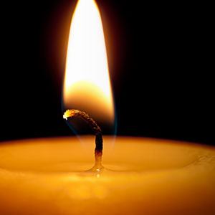
Parable of 4 Candles

